Slide 1

Analyzing the Impact of Influencers on Marketing Campaigns
Nikhil Aravind Dandamudi
Nikhil Kumar Samudrala
Sai Sashank Yalamarthi
Krishna Teja Akubathini
Gouri Manohari Katepalli

Slide 2

ABSTRACT
This study aims to investigate the impact of influencers on marketing activities by analyzing data collected from various social media platforms. Specifically, the project will focus on the period between March and December 2022, and will use information such as follower counts, engagement rates, and brand collaborations to evaluate the success of marketing campaigns. Through regression analysis and correlation analysis, the project will assess the relationship between influencer characteristics and the effectiveness of marketing campaigns and will also compare the performance of different tiers of influencers. The study will also explore the influence of product categories and individual influencers on consumer perceptions of the brand. By utilizing data visualization techniques, the study seeks to provide actionable insights to brands seeking to integrate influencer marketing into their marketing strategy, while also contributing to the existing body of research in this area.

Slide 3
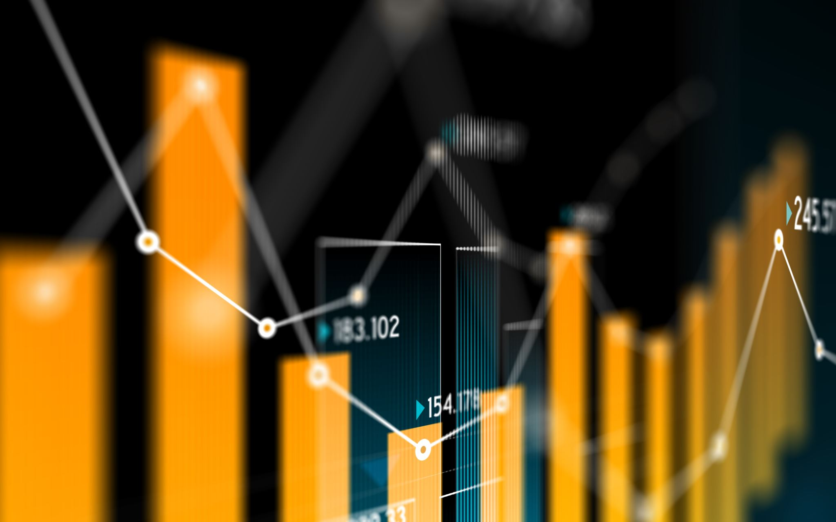
Data description and potential statistical tests
The data provided is a list of Instagram influencers and their related information, including their username, category, number of followers, audience country, and engagement statistics. This data can be used for various purposes, such as analyzing influencer performance and understanding factors that contribute to sales generated from marketing. Statistical tools such as descriptive statistics, visualization, correlation analysis, regression analysiscan be used to analyze the data. The given data provides a valuable resource for conducting exploratory data analysis and identifying insights related to social media influencer marketing.

Slide 4
Resources and Related Projects
Libraries used in the project:
Matplotlib: a plotting library for Python.
Pandas: a library for data manipulation and analysis.
Numpy: a library for numerical computation.
Seaborn: a library for data visualization.
Sweetviz: a library for automated data visualization and analysis.
Dataset used in the project:
A CSV file containing social media influencer data on Instagram.
Tutorials used for reference:
"Data Cleaning with Python" by Real Python (freely available): a tutorial on data cleaning using Pandas library.
"Exploratory Data Analysis in Python" by DataCamp (freemium): a tutorial on data visualization and analysis using Matplotlib and Pandas libraries.

Slide 5
Contrasting details for related tutorials
"Python for Data Science Handbook" by Jake VanderPlas (freely available): a comprehensive tutorial on data science in Python, covering topics such as data manipulation, visualization, and analysis using various libraries including Pandas, Matplotlib, and Seaborn.
"Data Science with Python" by IBM (freemium): a tutorial series covering topics such as data cleaning, data visualization, and machine learning using Python and various libraries including Pandas, Matplotlib, and Scikit-learn. The tutorial also includes a project on analyzing a dataset of social media influencers.

Slide 6
Data Specification
Data set(s): Social media influencers on Instagram
Features:
Subscriber count
Average engagement rate
Username
Category/niche
Follower growth rate
Type and number of samples:
Type: CSV file
Number: 1000 influencers
The data may be used for analyzing the influencer marketing landscape, identifying trends in engagement rates, and predicting the success of influencer marketing campaigns.

Slide 7
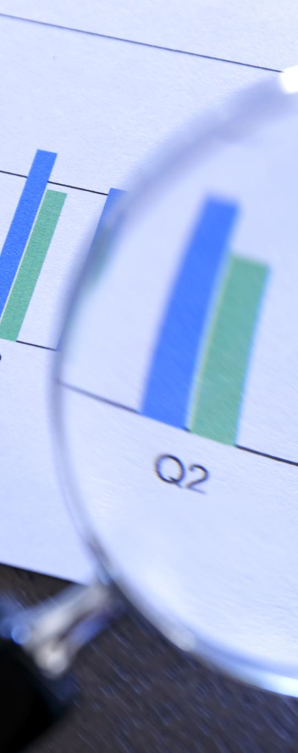
Project Design
Tools and frameworks:
Libraries: matplotlib, pandas, numpy, seaborn, sweetviz
Models used:
Data cleaning: checking for missing data, replacing infinity values with NaN, dropping rows with missing data, renaming columns, removing duplicate rows
Data analysis: generating a report using sweetviz library, plotting histograms, scatter plots, heat maps, and bar charts for visualization
Statistical analysis: calculating basic statistics, correlation analysis, and linear regression modeling

Slide 8
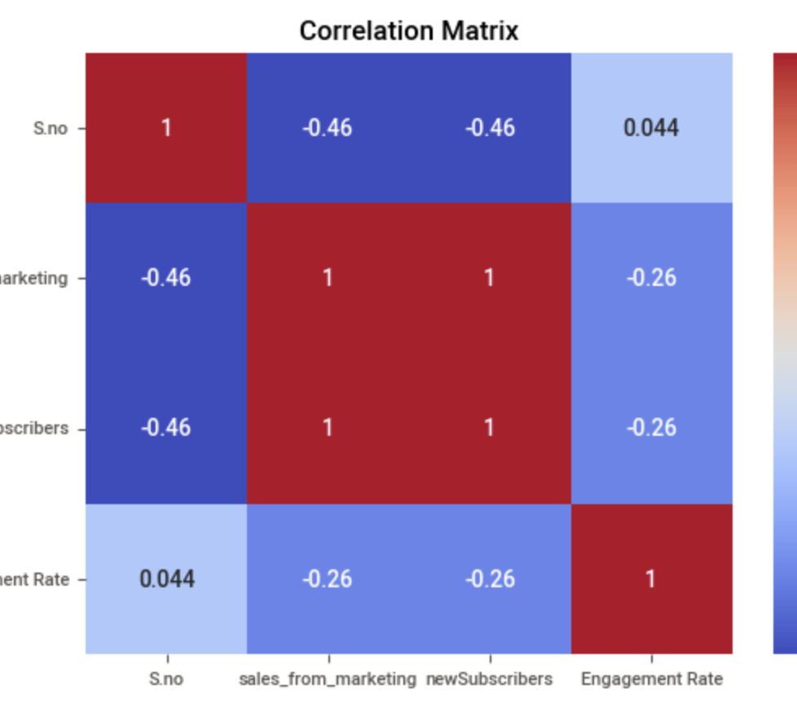
Exploratory data analysis

Slide 9
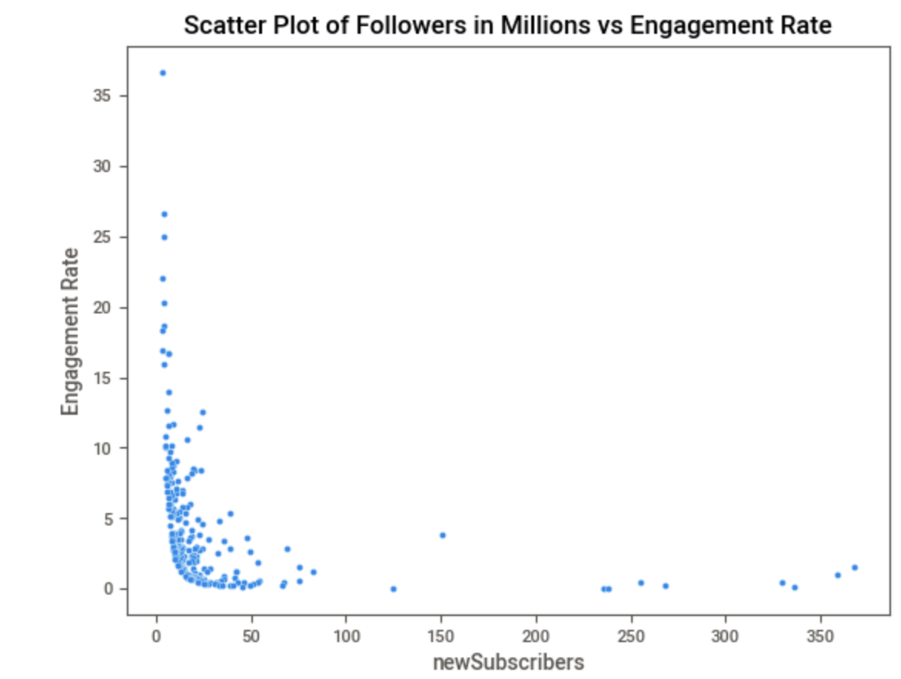

Slide 10
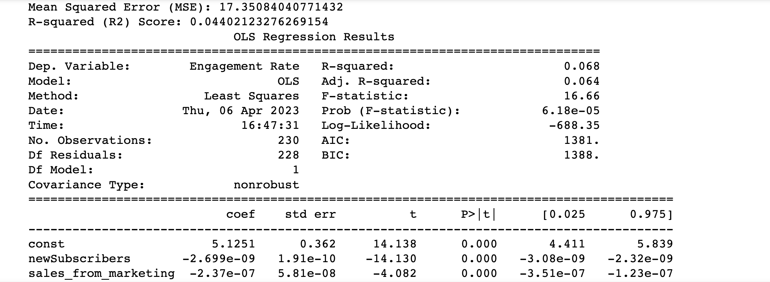
Statistical Test
basic statistics, correlation analysis,linear regression modeling and multiple linear regression

Slide 11
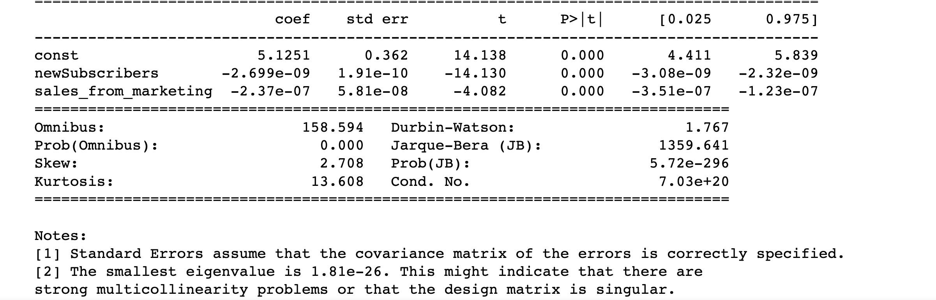

Slide 12
Milestones
WEEK NO. | TASK/MILESTONE
01 | Data Collection and Review.
02 | Data Cleaning and Descriptive analysis.
03 | Regression Analysis and Hypothesis testing.
04 | Final Review and Documentation.

Slide 13
Repository / Archive
Repository Link: https://github.com/SaiSashankYalamarthi/Analyzing-the-Impact-of-Influencers-on-Marketing-campaigns-
Our repository contains all the necessary code, data, and documentation needed to reproduce our results. The project is organized into several folders, including:
Code: Contains all Python scripts used for data cleaning, visualization, and analysis
Data: Contains the original CSV file of Instagram influencers and the cleaned dataset used for analysis
Reports: Contains the Sweetviz report and all visualizations generated during analysis
Docs: Contains a README file with setup instructions and documentation on the project structure and files

Slide 14
Conclusion
Our project involved analyzing social media influencers on Instagram using Python. We cleaned the data, calculated engagement rates, and generated visualizations using sweetviz. We performed statistical analysis and found a positive correlation between subscriber count and engagement rate. To continue this project, one could explore content and hashtags used by influencers to increase engagement and expand the dataset to include influencers on other platforms. This project demonstrates the potential of data analysis and visualization techniques in gaining insights into social media marketing.

Slide 15
What’s Next ?
Explore other social media platforms to compare influencer performance.
Develop a machine learning model to predict engagement rate based on influencer characteristics.
Conduct a sentiment analysis of influencer posts to identify trends and themes.
Investigate the relationship between influencer content and follower demographics.
Create an influencer marketing strategy based on the insights gained from the analysis.

Slide 16
THANK YOU
Github:-https://github.com/SaiSashankYalamarthi/Analyzing-the-Impact-of-Influencers-on-Marketing-campaigns-

